Slide 1

Dennington Primary School
Calculation Policy
This guidance has been produced as a guide to indicate the progression through Addition, Subtraction, Multiplication and Division (including fractions) in Years 1 – 6. It has been developed from White Rose materials and guidance.
This document is to support teachers, teaching assistants and parents by showing clearly the methods and algorithms that children will be expected to use.
Teachers should not feel compelled to dwell on expanded methods if, in their professional judgement, pupils are ready to move to more efficient approaches.
Teachers should endeavour to ensure that children are working on the approaches expected for their age.

Slide 2

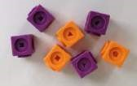
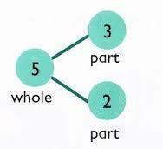

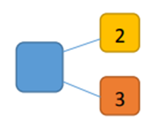

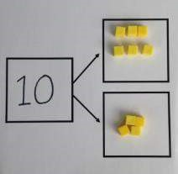
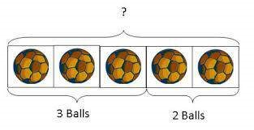


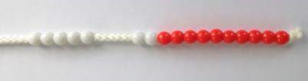

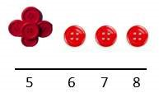
Objective |  | Concrete | Pictorial | Abstract
Year 1 | Number bonds of 5, 6, 7, 8, 9 and 10
 | Counting
Use cubes to add two numbers together as a group or in a bar.
Use pictures to add two numbers together as a group or in a bar.
Use the part-part-whole diagram as shown above to move into the abstract.
Use a number line to count on in ones.
Start with the larger number on the bead string and then count on to the smaller number 1 by 1 to find the answer.

Slide 3

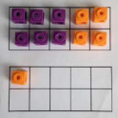
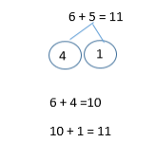

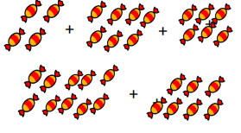


Objective |  | Concrete | Pictorial | Abstract
Year 1 | Regrouping to make 10
 | Adding 3 single digit numbers
6 + 5 = 11
6 + 5 = 11
Start with the bigger number and use the smaller number to make 10.
Use pictures to add two numbers together as a group or in a bar.
Put 4 and 6 together to make 10. Add on 7.
Combine the two numbers that make 10 and then add on the remainder.
Following on from making 10, make 10 with 2 of the digits (if possible) then add on the third digit.
Add together three groups of objects. Draw a picture to recombine the groups to make 10.

Slide 4
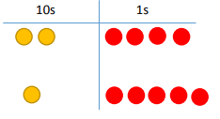


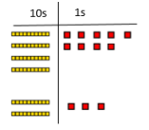
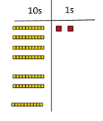
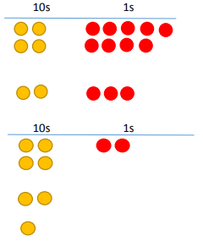
Objective |  | Concrete | Pictorial | Abstract
Year 2 | Column method without regrouping |  |  | 24 + 15 = 39 24 + 15 39
 | Column method with regrouping |  |  | 40 + 9 20 + 3 60 + 12 = 72
Add together the ones first, then add the tens. Use the Base 10 blocks first before moving onto place value counters.
24 + 15 = 44 + 15 =
After physically using the base 10 blocks and place value counters, children can draw the counters to help them to solve additions.
Make both numbers on a place value grid.
Add up the units and exchange 10 ones for 1 ten.
Using place value counters, children can draw the counters to help them to solve additions.

Slide 5
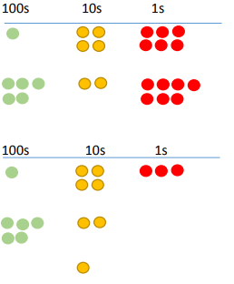
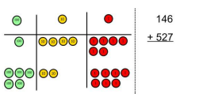
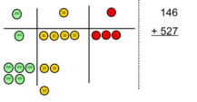
Objective |  | Concrete | Pictorial | Abstract
Year 3-4 | Column method with regrouping | Make both numbers on a place value grid. Add up the units and exchange 10 ones for 1 ten. As children move on to decimals, money and decimal place value counters can be used to support learning. NB By Year 4 children will progress on to adding 2 digit numbers. |  | 100 + 40 + 6 +500 + 20 + 7 600 + 70 + 3 = 673 As the children progress, they will move from the expanded to the compacted method. 146 + 527 673 1 As the children move on, introduce decimals with the same number of decimal places and different. Money can be used here.
 | Column method with regrouping | Consolidate understanding using numbers with more than 4 digits and extend by adding numbers with up to 3 decimal places.
Children can draw a pictorial representation of the columns and place value counters to further support their learning and understanding.
NB Addition of money needs to have £ and p added separately.

Slide 6



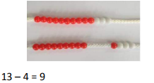

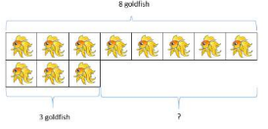
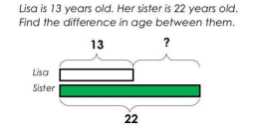
Objective |  | Concrete | Pictorial | Abstract
Year 1 | Taking away ones
 | Counting back
 | Find the difference
Use physical objects, counters, cubes etc. to show how objects can be taken away.
Cross out drawn objects to show what has been taken away.
4 – 2 = 2
Make the larger number in your subtraction. Move the beads along your bead string as you count backwards in ones
Count back on a number line or number track.
Start at the bigger number and count back the smaller number, showing the jumps on the number line.
Count on to find the difference.
Draw bars to find the difference between 2 numbers.
Put 13 in your head, count back 4. What number are you at? Use your fingers to help.
Compare amounts and objects to find the difference.
Use cubes to build towers or make bars to find the difference. Use basic bar models with items to find the difference.
Hannah has 8 goldfish. Helen has 3 goldfish. Find the difference between the number of goldfish the girls have

Slide 7
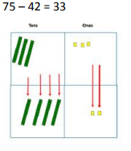
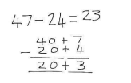
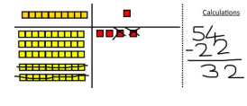


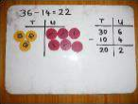
Objective |  | Concrete | Pictorial | Abstract
Year 2 | Column method without regrouping | Use Base 10 to make the bigger number then take the smaller number away. Show how you partition numbers to subtract. Again make the larger number first.
Draw the Base 10 or place value counters alongside the written calculation to help to show working.
This will lead to a clear written column subtraction.

Slide 8
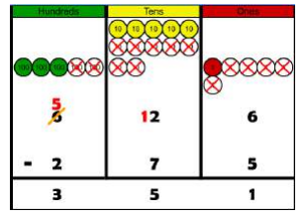
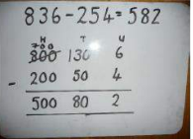
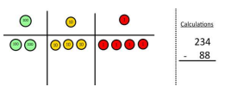
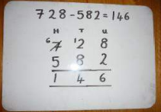

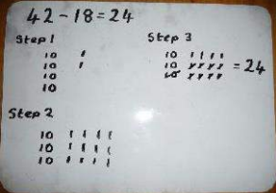
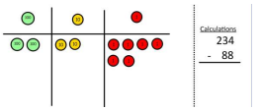
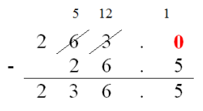
Objective |  | Concrete | Pictorial | Abstract
Year 3+ | Column method with regrouping | Use Base 10 to start with before moving on to place value counters. Start with one exchange before moving onto subtractions with 2 exchanges. Make the larger number with the place value counters. Start with the ones, can I take away 8 from 4 easily? I need to exchange 1 of my tens for 10 ones. Now I can subtract my ones.
Children can start their formal written method by partitioning the number into clear place value columns.
Moving forward the children use a more compact method.
This will lead to an understanding of subtracting any number including decimals.
Draw the counters onto a place value grid and show what you have taken away by crossing the counters out as well as clearly showing the exchanges you make.
When confident, children can find their own way to record the exchange/regrouping.
Just writing the numbers as shown here shows that the child understands the method and knows when to exchange/regroup.

Slide 9
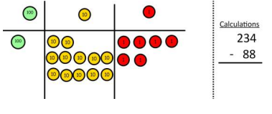
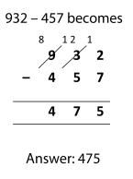
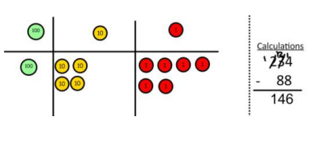
Objective |  | Concrete | Pictorial | Abstract
Year 3+ | Column method with regrouping | Now look at the tens, can I take away 8 tens easily? I need to exchange 1 hundred for 10 tens. Now I can take away 8 tens and complete my subtraction. Show children how the concrete method links to the written method alongside your working. Cross out the numbers when exchanging and show where we write our new amount.

Slide 10
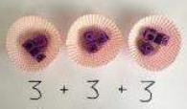
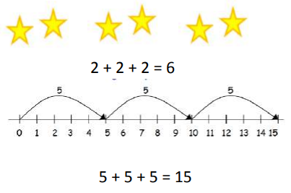
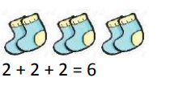
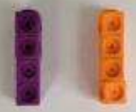

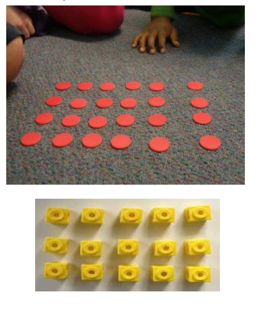

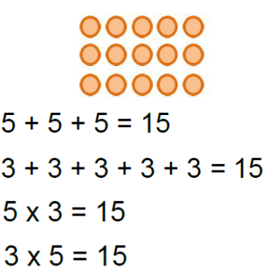
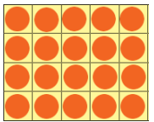
Objective |  | Concrete | Pictorial | Abstract
Years 1-2 | Repeated addition
 | Arrays- showing commutative multiplication
Use different objects to add equal groups.
There are 3 plates. Each plate has 2 star biscuits on. How many biscuits are there?
Write addition sentences to describe objects and pictures.
Create arrays using counters/cubes to show multiplication sentences.
Draw arrays in different rotations to find commutative multiplication sentences.
Link arrays to area of rectangles.
Use an array to write multiplication sentences and reinforce repeated addition.
2 x 4 = 8
4 × 2 = 8
4 × 2 = 8
2 x 4 = 8

Slide 11
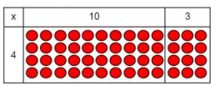
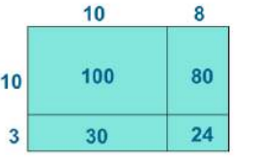
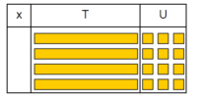
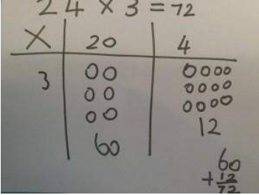
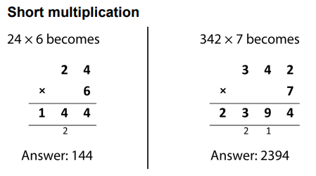
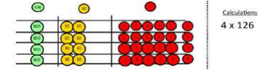
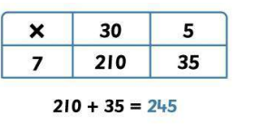
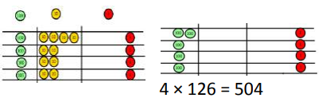
Objective |  | Concrete | Pictorial | Abstract
Year 3-4 | Grid method | Show the link with arrays to first introduce the grid method. 4 rows of 10 4 rows of 3 Move on to using Base 10 to move towards a more compact method. 4 rows of 13 Move on to place value counters to show how we are finding groups of a number. We are multiplying by 4 so we need 4 rows. Fill each row with 126. Add up each column, starting with the ones making any exchanges needed.
Children can represent the work they have done with place value counters in a way that they understand. They can draw the counters, using colours to show different amounts or just use circles in the different columns to show their thinking as shown below:
Moving forward, multiply by a 2 digit number showing the different rows within the grid method.
Multiply two-digit and three-digit numbers by a one-digit number using formal written layout.
Start with multiplying by one digit numbers and showing the clear addition alongside the grid.

Slide 12
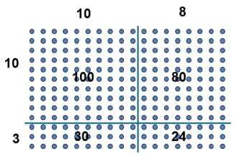






Objective |  | Concrete | Pictorial | Abstract
Year 5-6 | Expanded method
 | Compact method
Show the link with arrays to first introduce the expanded method.
Start with long multiplication, reminding the children about lining up their numbers clearly in columns.
Children can continue to be supported by place value counters at the stage of multiplication.
It is important at this stage that they always multiply the ones first and note down their answer followed by the tens which they note below.
Bar modelling and number lines can support learners when solving problems with multiplication alongside the formal written methods.
Start with long multiplication, reminding the children about lining up their numbers clearly in columns. If it helps, children can write out what they are solving next to their answer.
This moves to the more compact method.

Slide 13





Objective |  | Concrete | Pictorial | Abstract
Year 1-2 | Sharing
 | Grouping
I have 8 cubes, can you share them equally between two people?
Share 8 buns between two people.
Children use pictures or shapes to share quantities.
Use a number line to show jumps in groups. The number of jumps equals the number of groups.
Divide 10 into 5 groups. How many are in each group?
10 ÷ 5 = 2
Think of the bar as a whole. Split it into the number of groups you are dividing by and work out how many would be within each group.
Divide quantities into equal groups. Use cubes, counters, objects or place value counters to aid understanding.

Slide 14







Objective |  | Concrete | Pictorial | Abstract
Year 3-4 | Division with arrays
 | Short division | Use place value counters to divide using the short division method alongside. 96 ÷3. Start with the biggest place value. 42 ÷ 3 We are sharing 40 into three groups. We can put 1 ten in each group and we have 1 ten left over. We exchange this ten for 10 ones and then share the ones equally among the groups. We look at how many are in each group.
Find the inverse of multiplication and division sentences by creating four linking number sentences.
5 x 3 = 15
3 x 5 = 15
15 ÷ 5 = 3
15 ÷ 3 = 5.
Draw an array and use lines to split the array into groups to make multiplication and division sentences.
Link division to multiplication by creating an array and thinking about the number sentences that can be created:
15 ÷ 3 = 5 5 x 3 = 15
15 ÷ 5 = 3 3 x 5 = 15
Students can continue to use drawn diagrams with dots or circles to help them divide numbers into equal groups.
Encourage them to move towards counting in multiples to divide more efficiently.
Begin with divisions that divide equally with no remainder.

Slide 15








Objective |  | Concrete | Pictorial | Abstract
Year 5-6 | Short division with remainders
Divide objects between groups and see how much is left over.
14 ÷ 3 =
28÷8=3r5
Jump forward in equal jumps on a number line then see how many more you need to jump to find a remainder.
Draw dots and group them to divide an amount and clearly show a remainder.
Complete written divisions and show the remainder using r.
Move onto divisions with a remainder. Once children understand remainders, begin to express as a fraction or decimal.

Slide 16

Objective |  | Concrete | Pictorial | Abstract
Year 6 | Long division
Children will use long division to divide numbers with up to 4 digits by 2 digit numbers.

Slide 17








Objective |  | Concrete | Pictorial | Abstract
Year 1 | Recognise, find and name a half as 1 of 2 equal parts of an object, shape or quantity
 | Recognise, find and name a quarter as 1 of 4 equal parts of an object, shape or quantity | Children begin to make sense of fractions as part of a whole through exploring the quartering of objects, shapes and quantities.
Children begin to make sense of fractions as part of a whole through exploring the halving of objects, shapes and quantities.
Links are made between the halving and quartering of real objects and children begin to recognise half and quarter shapes in different orientation and they explain why some shapes can be halved but not quartered.
Children begin to make links between fractions of shapes and quantities through the sharing of items as part of problem solving in varied contexts.

Slide 18







Objective |  | Concrete | Pictorial | Abstract
Year 2 | Recognise, find, name and write fractions 1/3, 1/4, 2/4 and 3/4 of a length, shape, set of objects or quantity.
 | Write simple fractions, for example 1/2 of 6 = 3 and recognise the equivalence of 2/4 and 1/2.
Children find fractions of the lengths of a piece of string, strip of paper, ribbon, shoelace, etc. by folding. Children should be encouraged to discover the strategy of halving and then halving again.
Each fraction is represented using varied shapes in different orientation.
Children explore finding fractions of quantities using objects by drawing on their knowledge and understanding of fraction of shape.
Children are given the opportunity to explore the meaning of the numerator by making links between the number of parts are shaded and the numerator.
Children solve problems involving finding fractions of a jug or container full of water, flour, sand etc. They are to explore the best possible way to be accurate using a range of containers.
Pupils are taught to find simple fractions of quantities using jottings and bar-modelling and through their understanding of the meaning of the numerator and the denominator.

Slide 19








Objective |  | All work with fractions at this stage involves elements of CPA
Year 3 | Recognise, find and write fractions of a discrete set of objects: unit fractions and non-unit fractions with small denominators
 | Add and subtract fractions with the same denominator within one whole using diagrams.
Children must be given the opportunity to explore equivalent fractions through varied shapes and representations and discover similarities and differences.
Solve problems that involve fractions using jottings and bar model.
Pupils compare and order fractions and come to a conclusion to generalise.
They should recognise the relationship between the numerators and the denominators and generalise based on their observations.
Pupils should be taught to count up and down in tenths; recognise that tenths arise from dividing an object into 10 equal parts and in dividing one-digit numbers or quantities by 10.

Slide 20






Objective |  | All work with fractions at this stage involves elements of CPA
Year 4 | Add and subtract fractions with the same denominator using diagrams
 | Solve problems involving increasingly harder fractions to calculate quantities, and fractions to divide quantities, including non-unit fractions where the answer is a whole number
Add and subtract fractions with the same denominator (within and beyond one whole)

Slide 21





Objective |  | All work with fractions at this stage involves elements of CPA
Year 4 | Count up and down in hundredths; recognise that hundredths arise when dividing an object by one hundred and dividing tenths by ten
 | find the effect of dividing a one- or two-digit number by 10 and 100, identifying the value of the digits in the answer as ones, tenths and hundredths
Children explore relationships between 1 whole, 10 tenths, 100 hundredths using shapes and the number line and identify how this changes when they compare 1 whole, 1 tenths and 1 hundredths.
Children explore with the use of diagrams how 1/4, 1⁄2 and 3⁄4 are expressed as decimal equivalents.

Slide 22







Objective |  | All work with fractions at this stage involves elements of CPA
Year 5-6 | Compare and order fractions, including fractions > 1
 | Recognise mixed numbers and improper fractions and convert from one form to the other and write mathematical statements > 1 as a mixed number [for example,2/5 + 4/5 = 6/5 = 11/5 ].

Slide 23





Objective |  | All work with fractions at this stage involves elements of CPA
Year 5 | Add and subtract fractions with the same denominator and denominators that are multiples of the same number.
 | Multiply proper fractions and mixed numbers by whole numbers, supported by materials and diagrams.
Using varied representations and the concept of grouping pupils investigate what happens when a mixed fraction is multiplied by a whole number. They come to a conclusion to generalise.

Slide 24




Objective |  | All work with fractions at this stage involves elements of CPA
Year 5 | Recognise the per cent symbol (%) and understand that per cent relates to ‘number of parts per hundred’, and write percentages as a fraction with denominator 100, and as a decimal.
Year 6 | Solve problems involving the calculation of percentages [for example, of measures and such as 15% of 360] and the use of percentages for comparison.
Use equivalent fractions to find %s of numbers.
Progress to multiple steps.

Slide 25



Objective |  | All work with fractions at this stage involves elements of CPA
Year 5-6 | Add and subtract fractions with different denominators and mixed numbers, using the concept of equivalent fractions.

Slide 26











Objective |  | All work with fractions at this stage involves elements of CPA
Year 6 | Multiply simple pairs of proper fractions, writing the answer in its simplest form [for example, 1⁄4 × 1⁄2 =1/8 ].
 | Divide proper fractions by whole numbers [for example, 1/3 ÷ 2 =1/6 ].
Children must learn that the word ‘of’ means the same as the symbol ‘x’.
KEEP this one the same.

